Slide 1
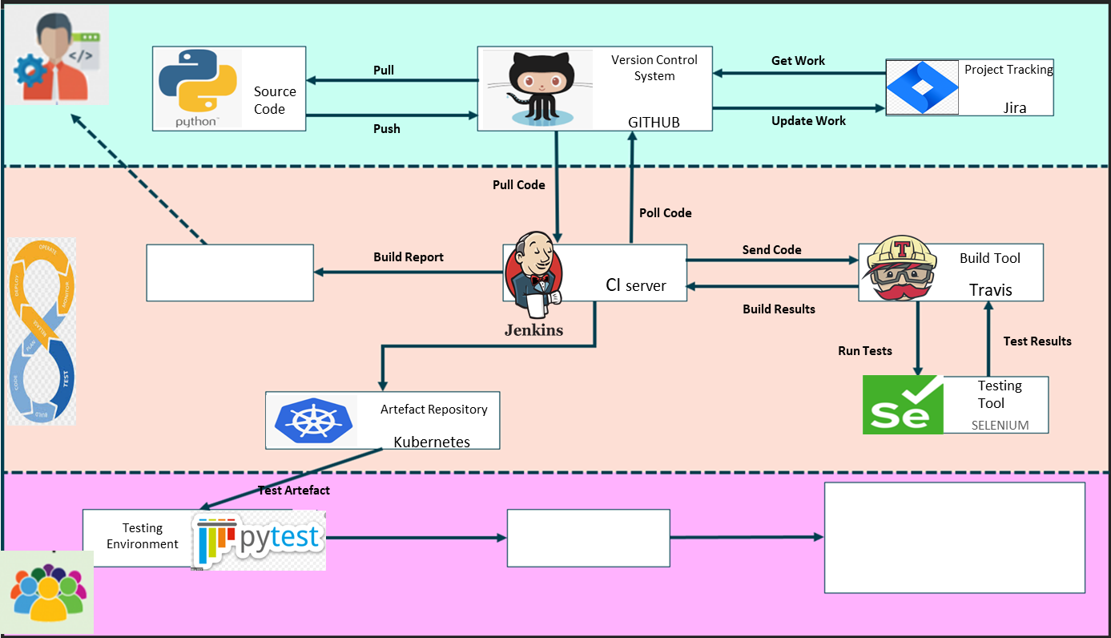
Developers
DEVOPS
Watch this space
Send Artefact
GitHub Repo
Watch this space
Coming Soon …….
Testers

Slide 2





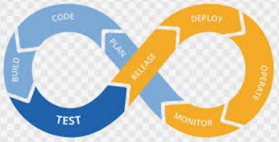




CI PIPELINE
Project Tracking
Developers
Jira
Source Code
Pull
Version Control System
Get Work
GITHUB
Update Work
Push
DEVOPS
Pull Code
Poll Code
Testing Tool
CI server
Send Code
SELENIUM
Build Results
Run Tests
Send Artefact
Testers
Testing Environment
Test Artefact

